Slide 1
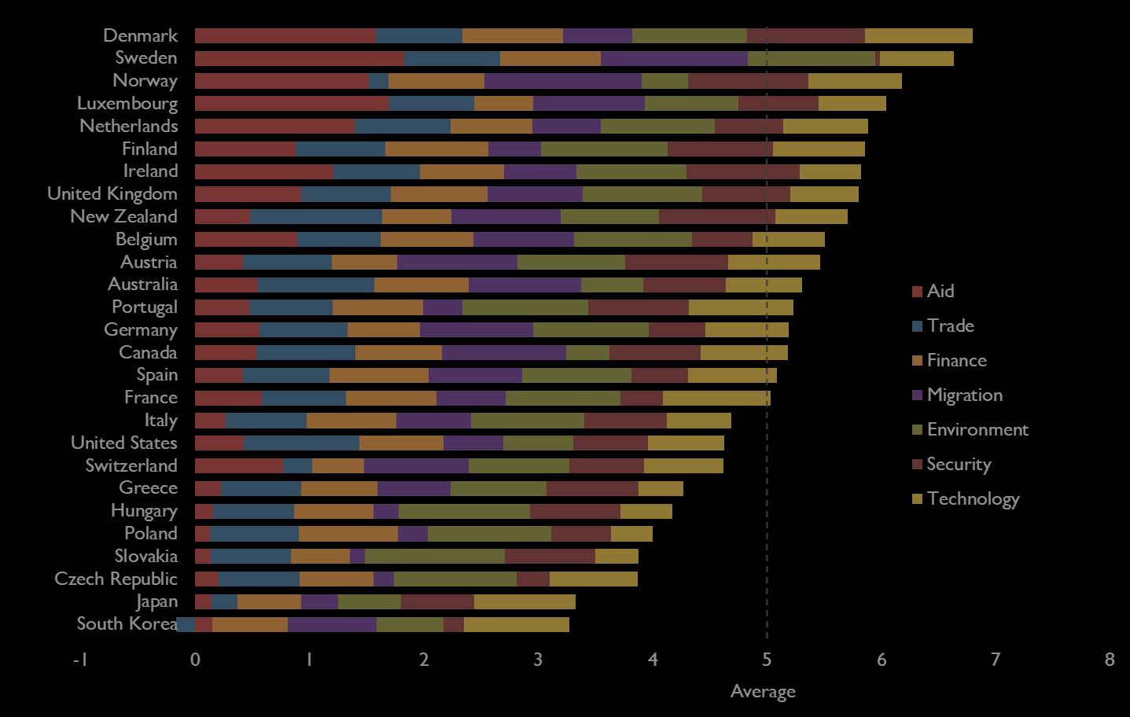
2013
Commitment to Development
Index

Slide 2
Components
Aid
Trade
Finance
Migration
Environment
Security
Technology

Slide 3
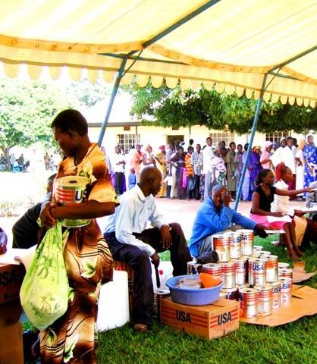
Aid
Quantity, net of debt payments
Tying
Selectivity
Project proliferation
Tax breaks for charity

Slide 4
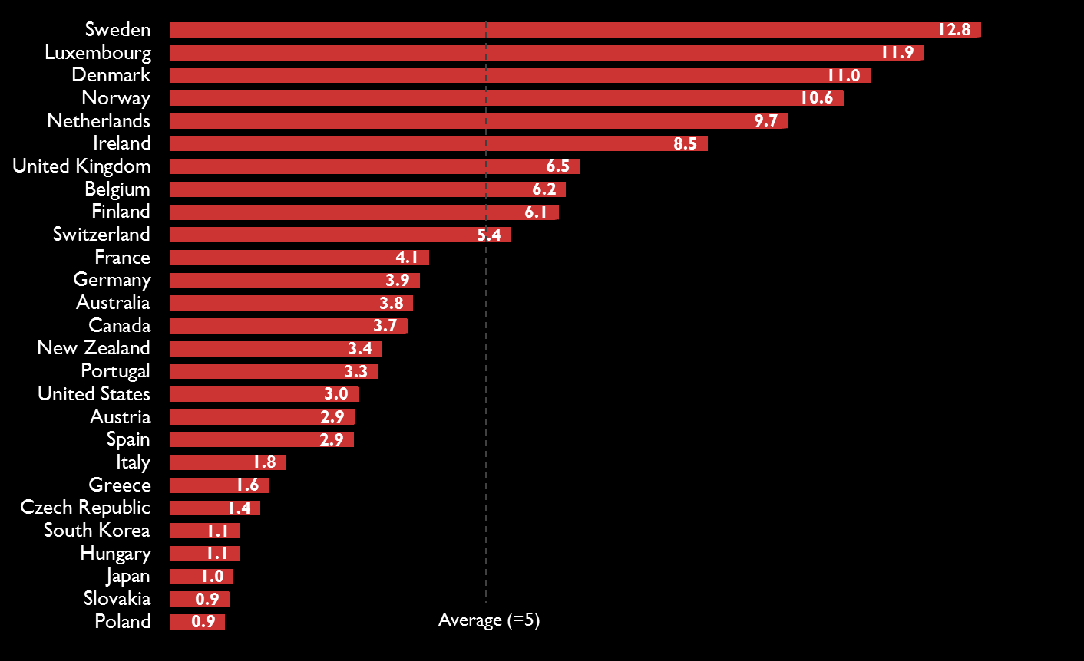
Aid

Slide 5
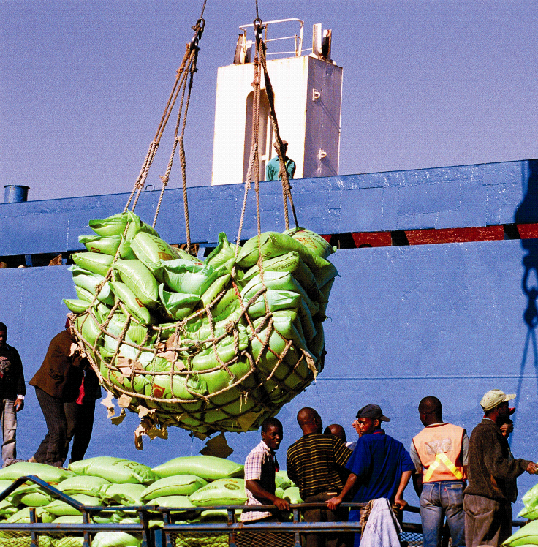
Trade
Tariffs
Quotas
Farm subsidies
Impediments to imports
Services trade restrictions

Slide 6
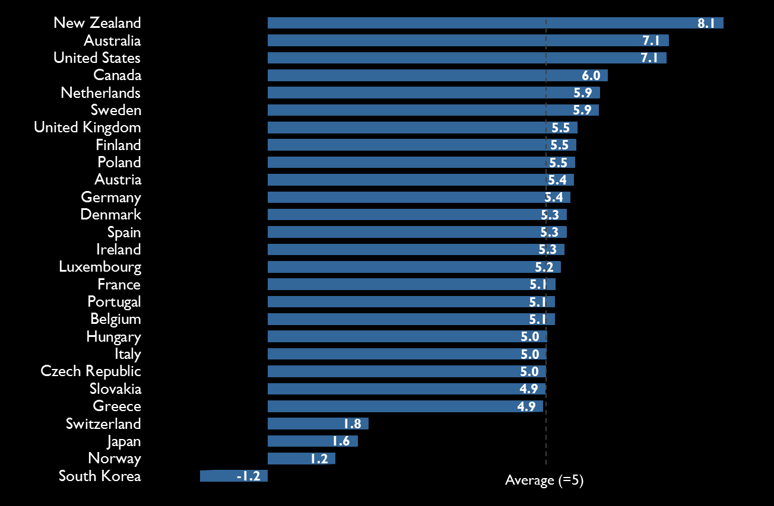
Trade

Slide 7
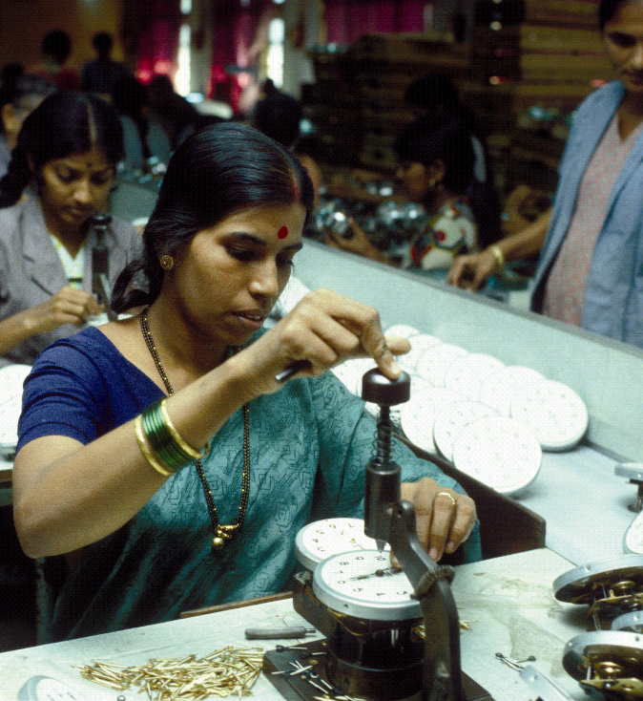
Finance
Political risk insurance
Bribery and corruption
Portfolio investment
Financial secrecy
More

Slide 8
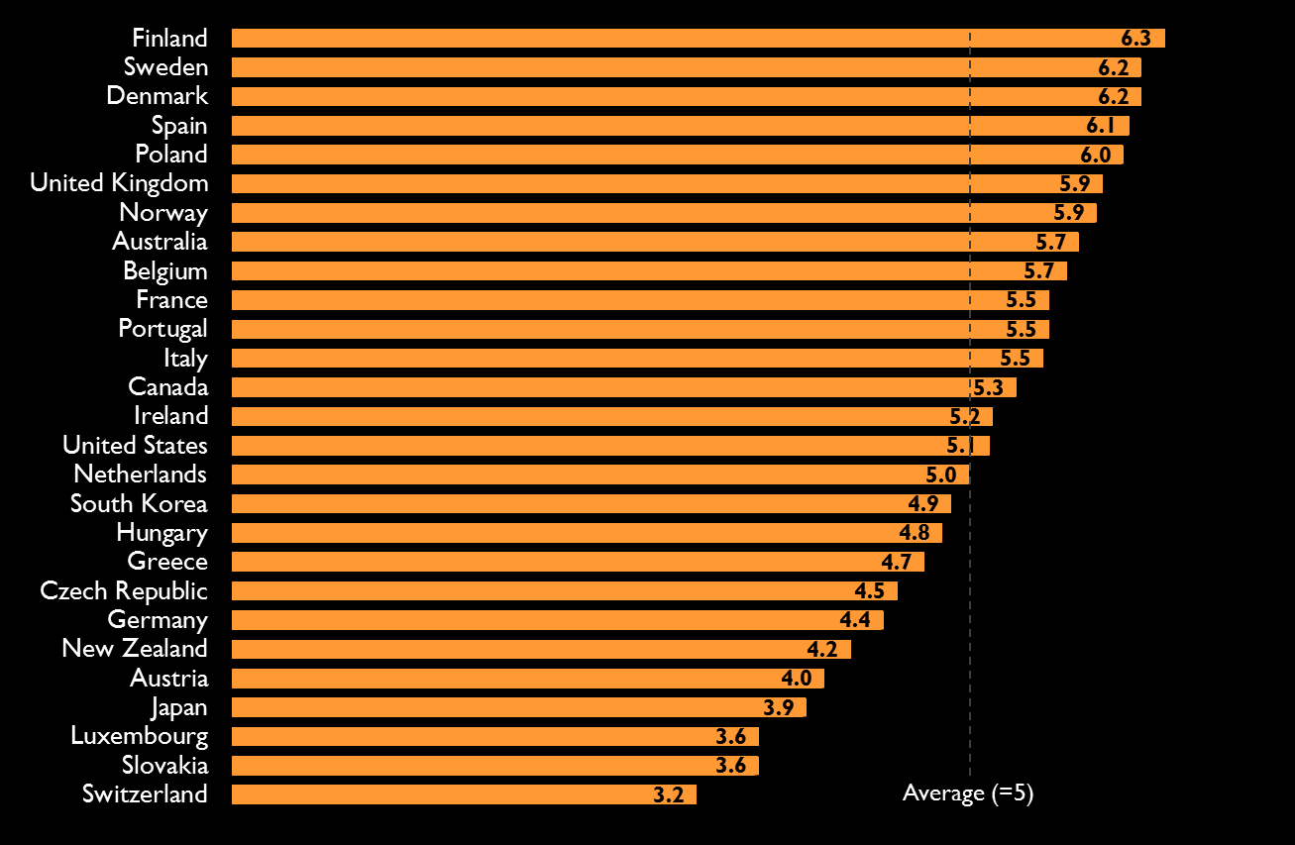
Finance

Slide 9
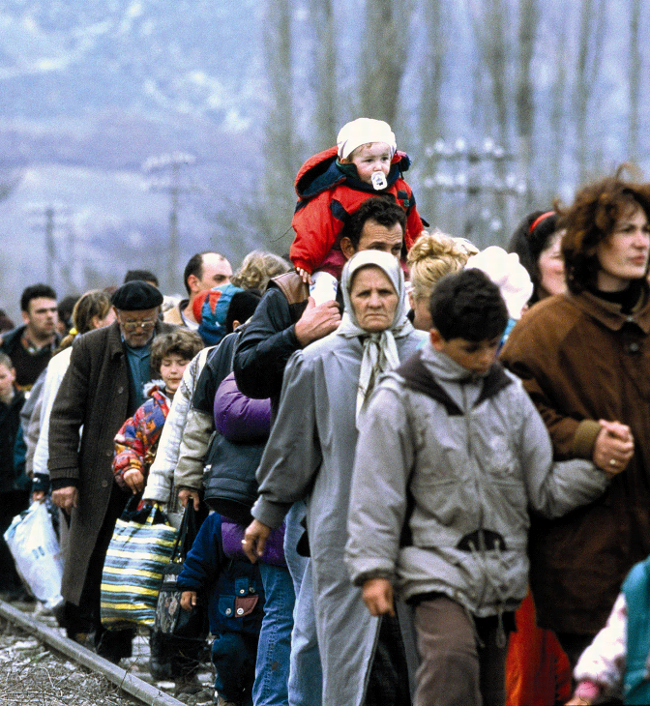
Migration
Immigration, especially unskilled
Foreign students from developing countries
Aid to refugees and asylum-seekers

Slide 10
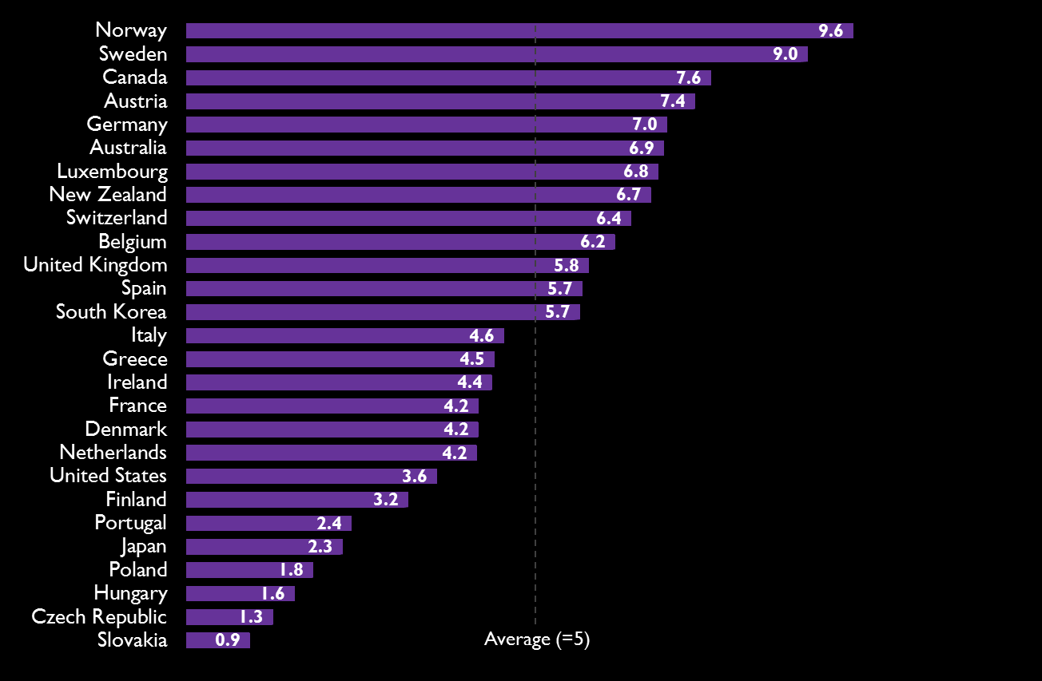
Migration

Slide 11
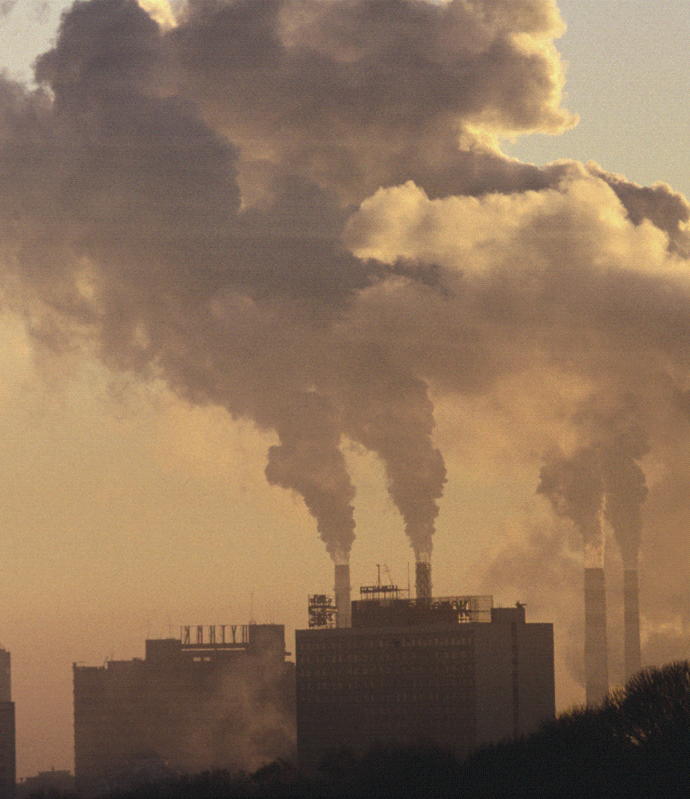
Environment
Greenhouse gas emissions
Gas taxes
Fishing subsidies
Tropical timber imports
More

Slide 12
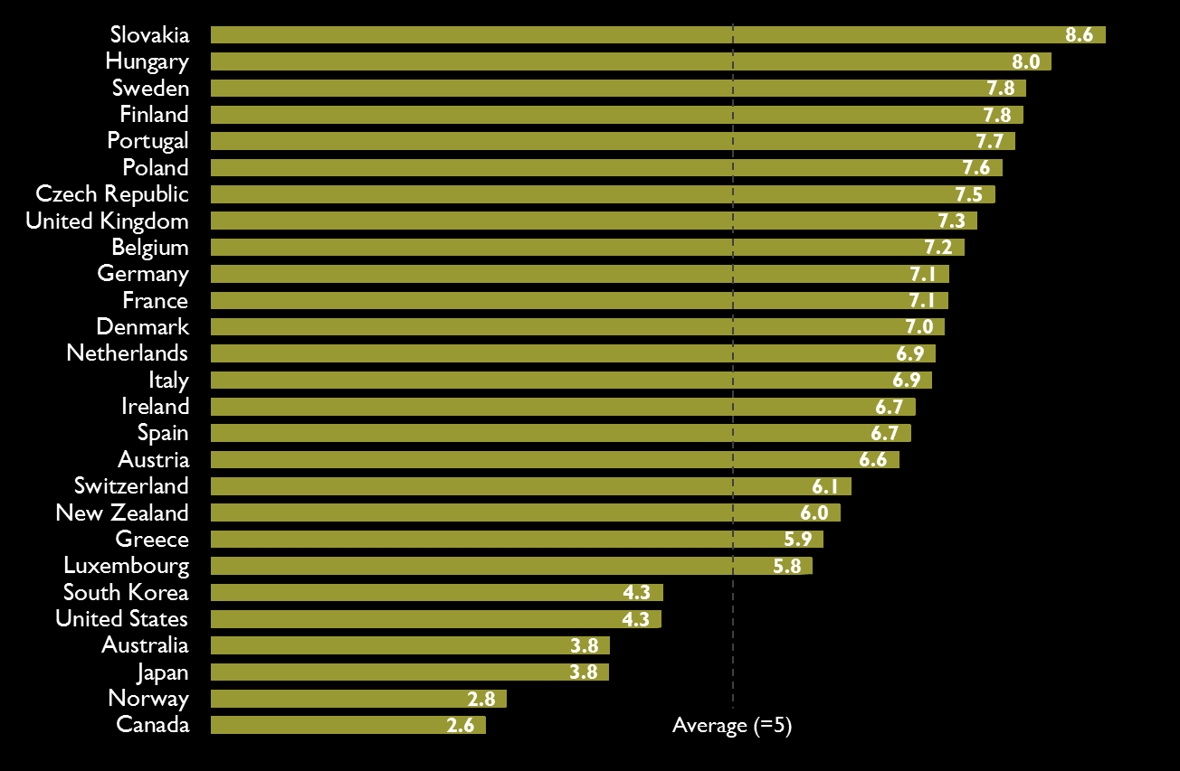
Environment

Slide 13
Security
$ + personnel to U.N. peacekeeping
Personnel to non-U.N.
Arms exports
Protecting sea lanes
International security treaties

Slide 14
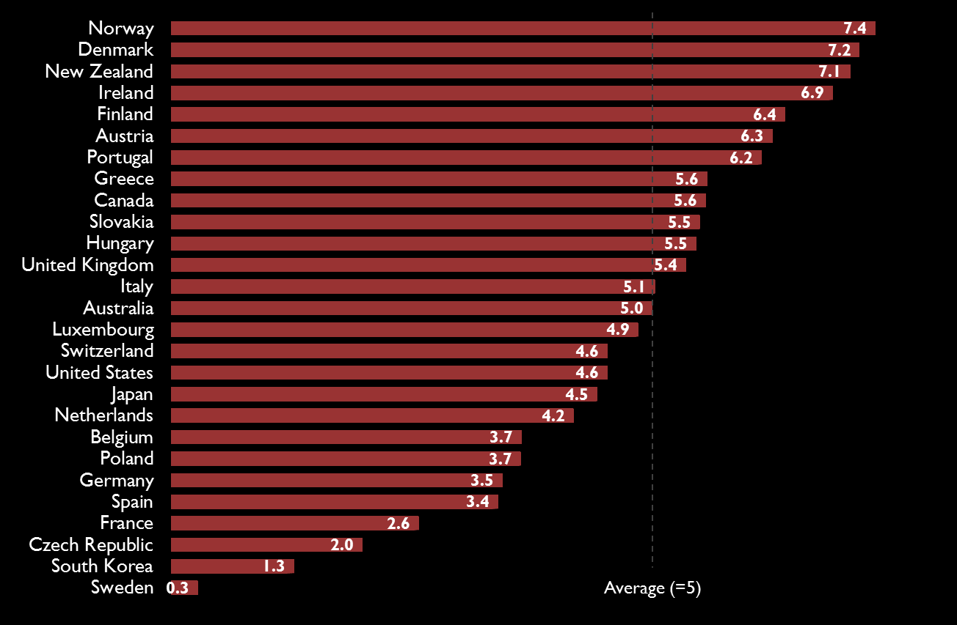
Security

Slide 15
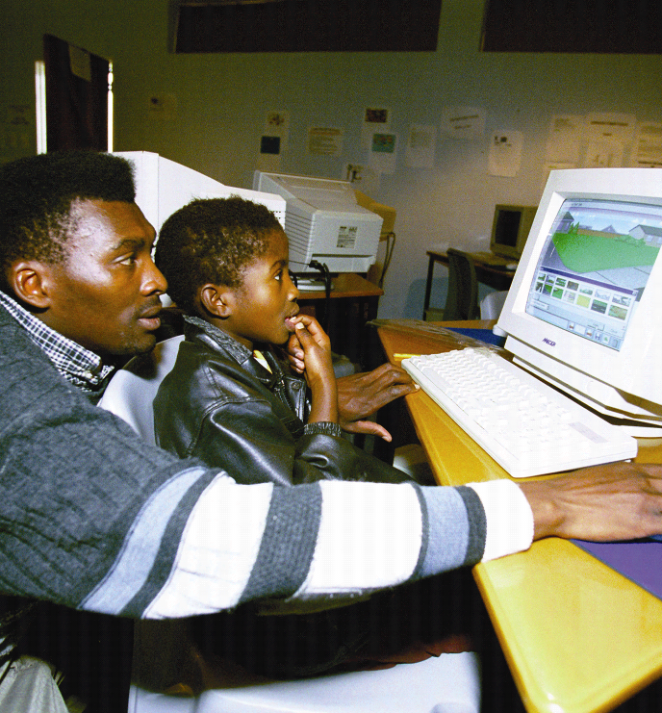
Technology
Public R&D spending
Tax breaks for R&D
Limiting intellectual property rights

Slide 16
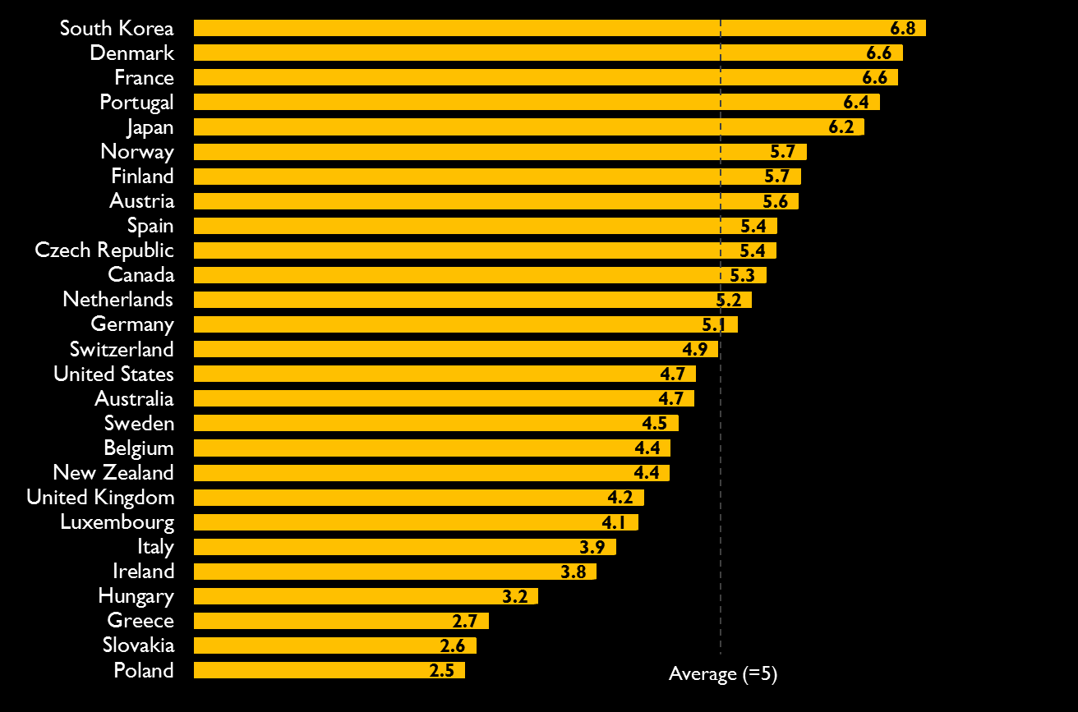
Technology

Slide 17
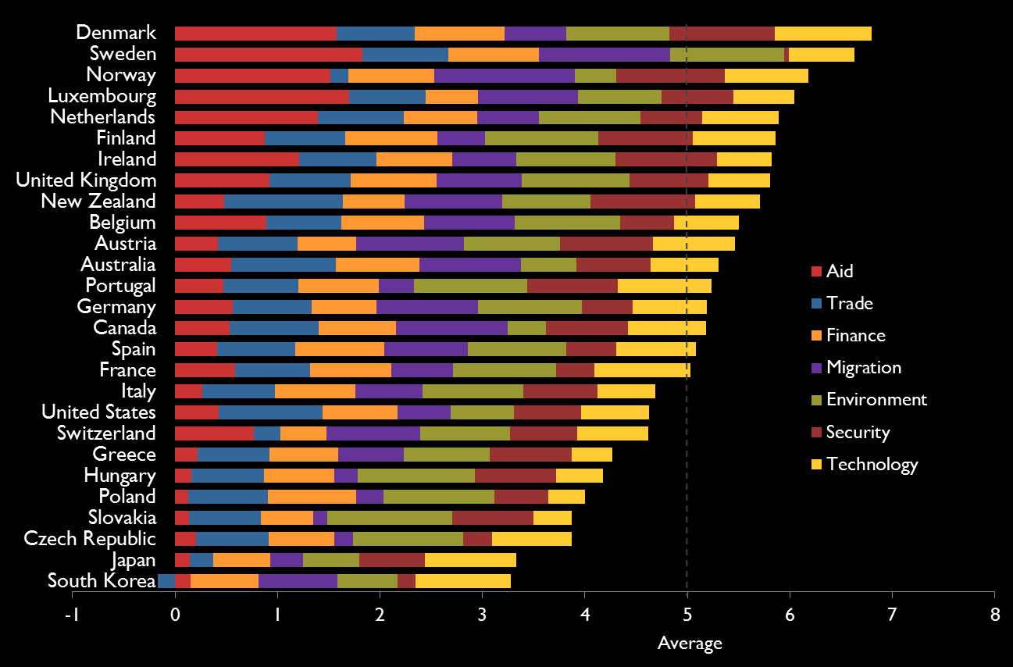
Overall

Slide 18
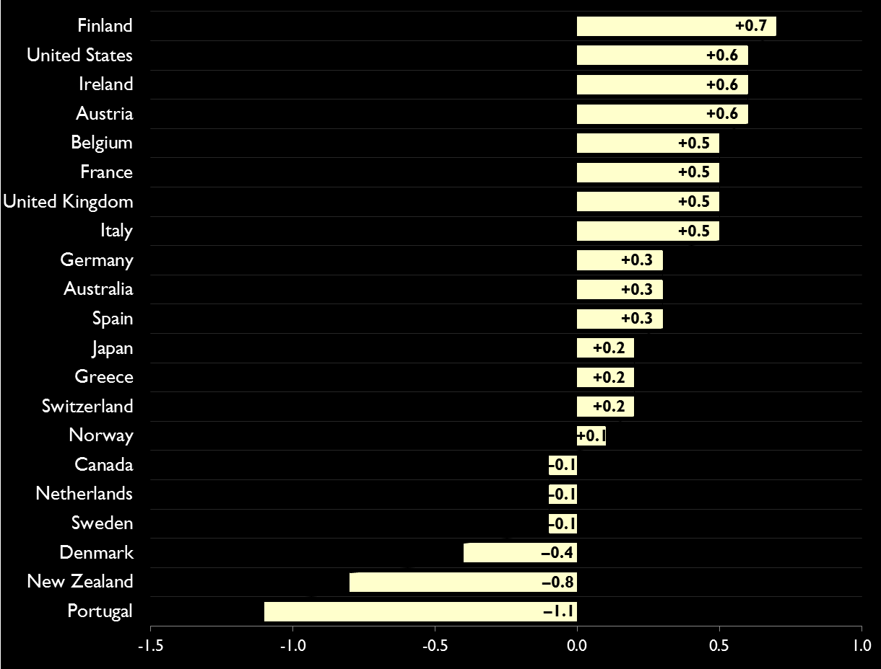
Change, 2003-13

Slide 19
Sources: Jörg Faust, Foreign Policy

Slide 20
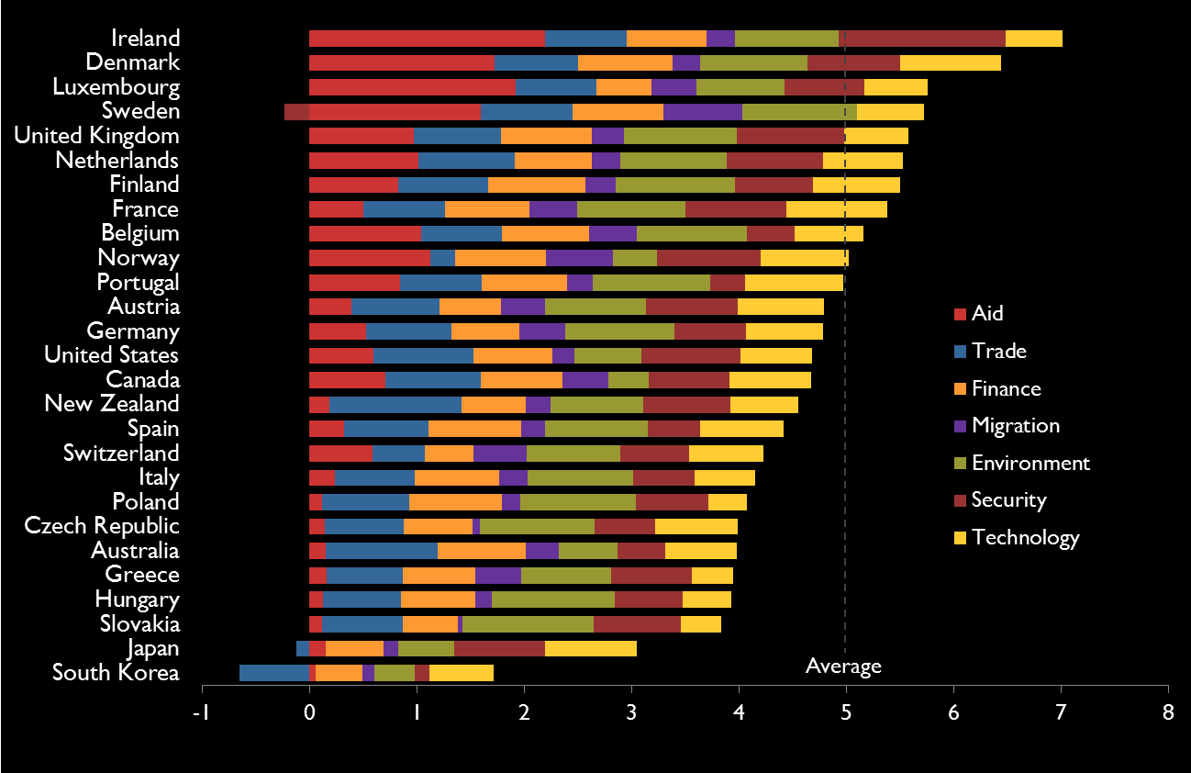
Sub-Saharan Africa

Slide 21
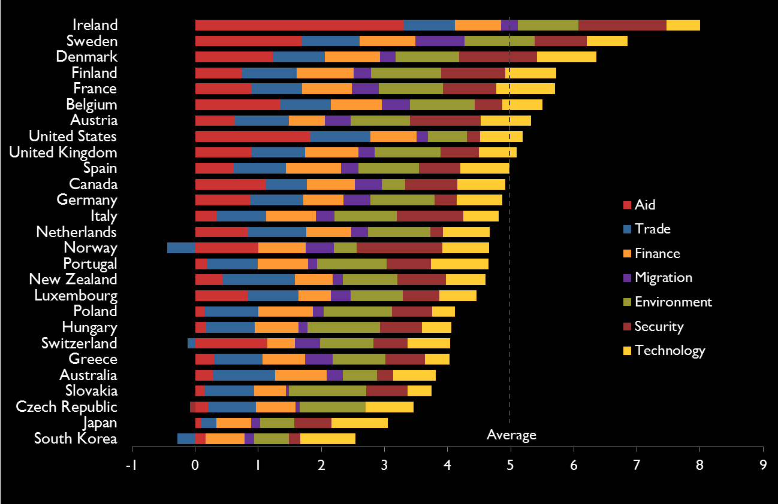
Middle East & North Africa

Slide 22
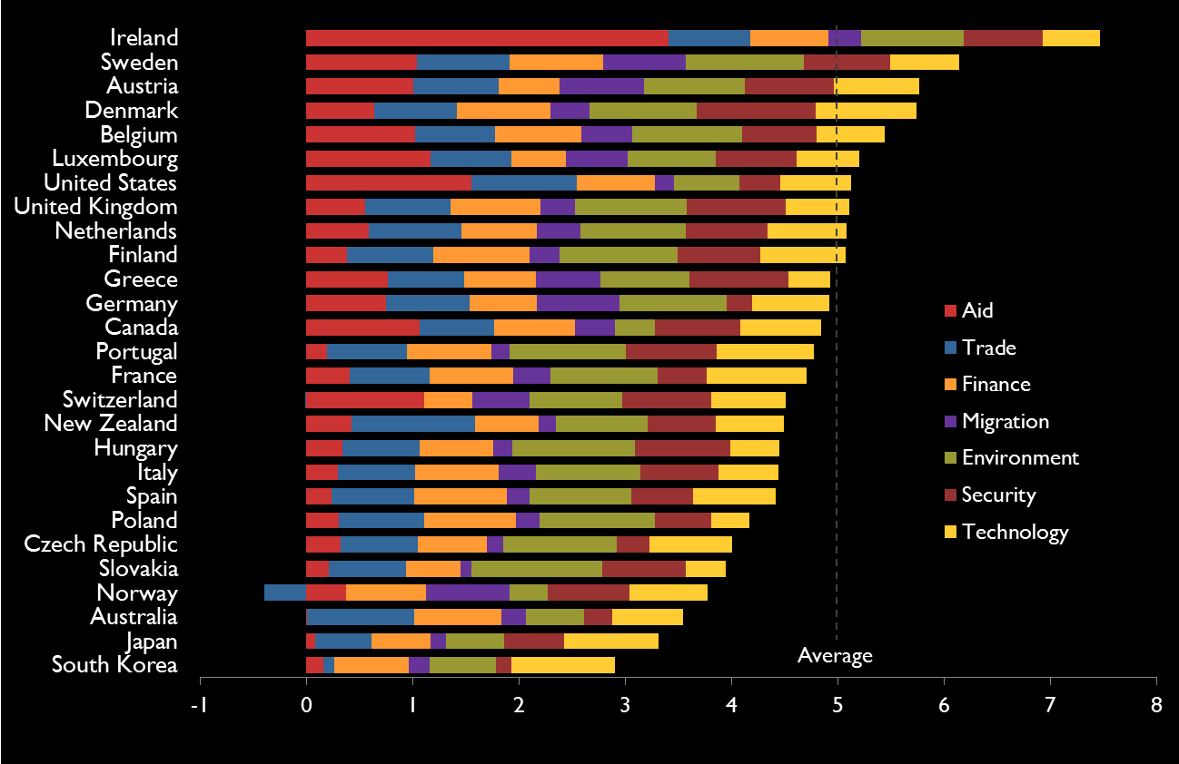
Europe and Central Asia

Slide 23
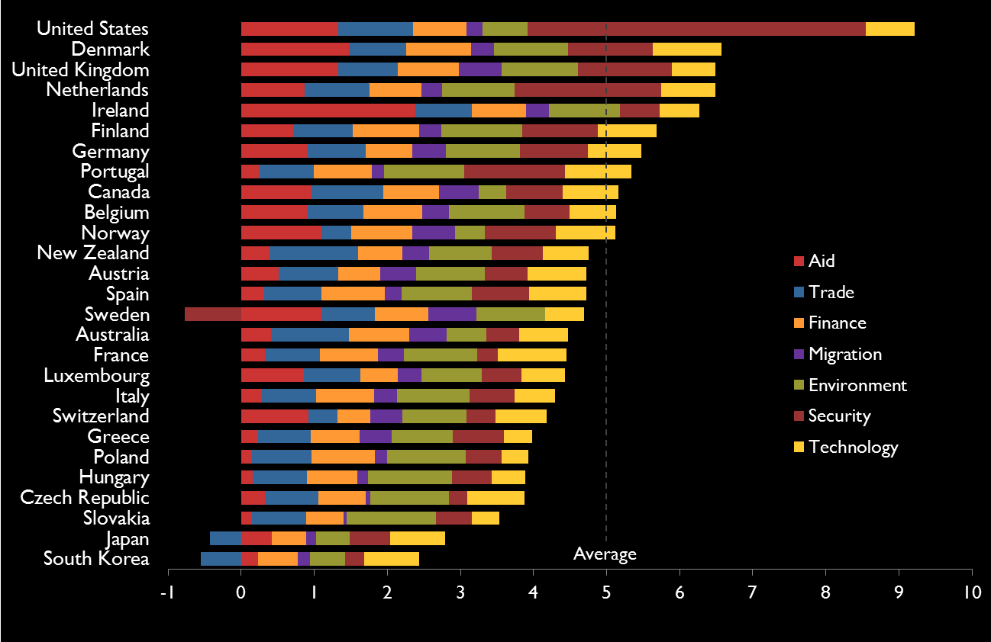
South Asia

Slide 24
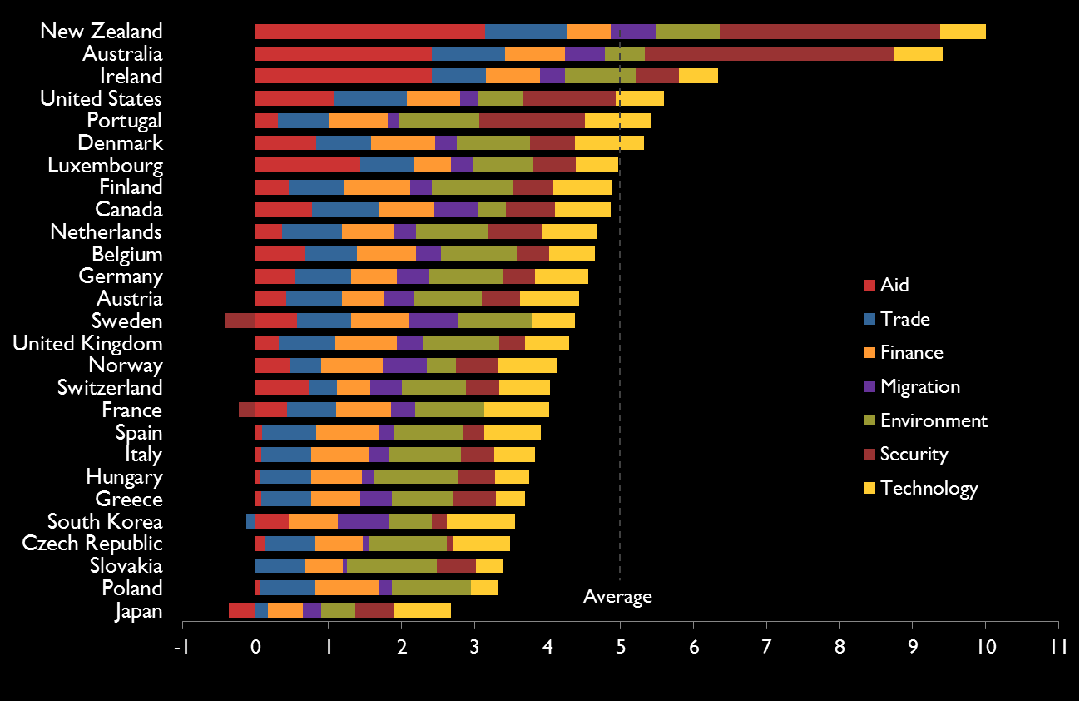
East Asia & Pacific

Slide 25
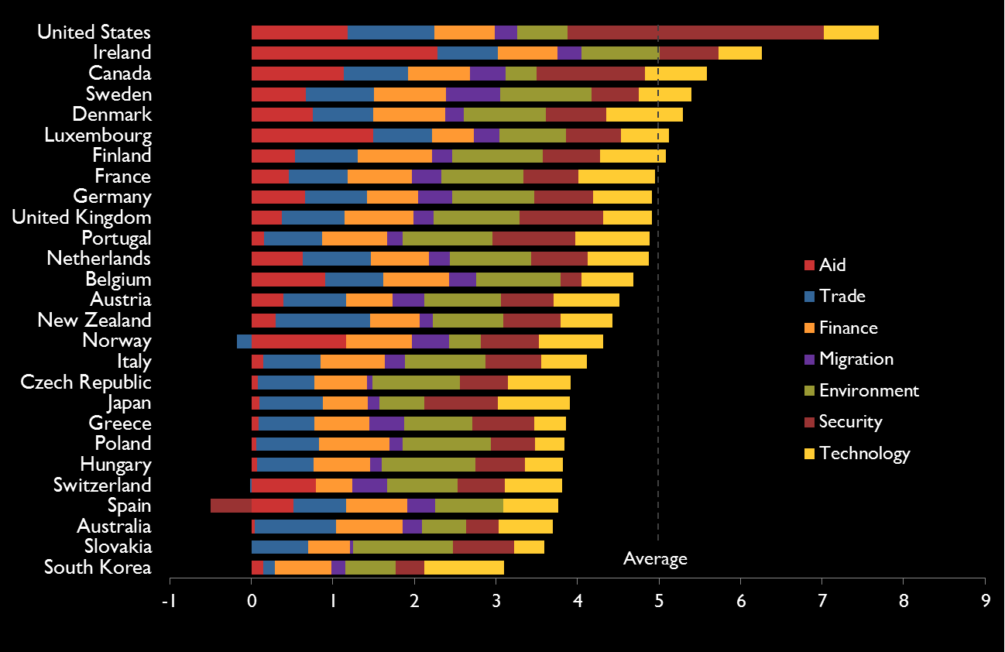
Latin America & Caribbean

Slide 26
cgdev.org/cdi

Slide 28
Overall
Rank | Country | Aid | Trade | Finance | Migration | Environment | Security | Technology | Overall (Average) | Change, 2003-2013
12 | Australia | 3.8 | 7.1 | 5.7 | 6.9 | 3.8 | 5.0 | 4.7 | 5.3 | +0.3
10 | Austria | 2.9 | 5.4 | 4.0 | 7.4 | 6.6 | 6.3 | 5.6 | 5.5 | +0.6
10 | Belgium | 6.2 | 5.1 | 5.7 | 6.2 | 7.2 | 3.7 | 4.4 | 5.5 | +0.5
13 | Canada | 3.7 | 6.0 | 5.3 | 7.6 | 2.6 | 5.6 | 5.3 | 5.2 | –0.1
24 | Czech Republic | 1.4 | 5.0 | 4.5 | 1.3 | 7.5 | 2.0 | 5.4 | 3.9 | N/A
1 | Denmark | 11.0 | 5.3 | 6.2 | 4.2 | 7.0 | 7.2 | 6.6 | 6.8 | –0.4
5 | Finland | 6.1 | 5.5 | 6.3 | 3.2 | 7.8 | 6.4 | 5.7 | 5.9 | +0.7
17 | France | 4.1 | 5.1 | 5.5 | 4.2 | 7.1 | 2.6 | 6.6 | 5.0 | +0.5
13 | Germany | 3.9 | 5.4 | 4.4 | 7.0 | 7.1 | 3.5 | 5.1 | 5.2 | +0.3
21 | Greece | 1.6 | 4.9 | 4.7 | 4.5 | 5.9 | 5.6 | 2.7 | 4.3 | +0.2
22 | Hungary | 1.1 | 5.0 | 4.8 | 1.6 | 8.0 | 5.5 | 3.2 | 4.2 | N/A
7 | Ireland | 8.5 | 5.3 | 5.2 | 4.4 | 6.7 | 6.9 | 3.8 | 5.8 | +0.6
18 | Italy | 1.8 | 5.0 | 5.5 | 4.6 | 6.9 | 5.1 | 3.9 | 4.7 | +0.5
26 | Japan | 1.0 | 1.6 | 3.9 | 2.3 | 3.8 | 4.5 | 6.2 | 3.3 | +0.2
4 | Luxembourg | 11.9 | 5.2 | 3.6 | 6.8 | 5.8 | 4.9 | 4.1 | 6.0 | N/A
5 | Netherlands | 9.7 | 5.9 | 5.0 | 4.2 | 6.9 | 4.2 | 5.2 | 5.9 | –0.1
9 | New Zealand | 3.4 | 8.1 | 4.2 | 6.7 | 6.0 | 7.1 | 4.4 | 5.7 | –0.8
3 | Norway | 10.6 | 1.2 | 5.9 | 9.6 | 2.8 | 7.4 | 5.7 | 6.2 | +0.1
23 | Poland | 0.9 | 5.5 | 6.0 | 1.8 | 7.6 | 3.7 | 2.5 | 4.0 | N/A
13 | Portugal | 3.3 | 5.1 | 5.5 | 2.4 | 7.7 | 6.2 | 6.4 | 5.2 | –1.1
24 | Slovakia | 0.9 | 4.9 | 3.6 | 0.9 | 8.6 | 5.5 | 2.6 | 3.9 | N/A
26 | South Korea | 1.1 | -1.2 | 4.9 | 5.7 | 4.3 | 1.3 | 6.8 | 3.3 | N/A
16 | Spain | 2.9 | 5.3 | 6.1 | 5.7 | 6.7 | 3.4 | 5.4 | 5.1 | +0.3
2 | Sweden | 12.8 | 5.9 | 6.2 | 9.0 | 7.8 | 0.3 | 4.5 | 6.6 | –0.1
19 | Switzerland | 5.4 | 1.8 | 3.2 | 6.4 | 6.1 | 4.6 | 4.9 | 4.6 | +0.2
7 | United Kingdom | 6.5 | 5.5 | 5.9 | 5.8 | 7.3 | 5.4 | 4.2 | 5.8 | +0.5
19 | United States | 3.0 | 7.1 | 5.1 | 3.6 | 4.3 | 4.6 | 4.7 | 4.6 | +0.6

Slide 29
Overall (EU)
Rank | Country | Aid | Trade | Finance | Migration | Environment | Security | Technology | Overall (Average)
1 | Norway | 10.6 | 1.2 | 5.9 | 9.6 | 2.8 | 7.4 | 5.7 | 6.2
2 | New Zealand | 3.4 | 8.1 | 4.2 | 6.7 | 6.0 | 7.1 | 4.4 | 5.7
3 | Australia | 3.8 | 7.1 | 5.7 | 6.9 | 3.8 | 5.0 | 4.7 | 5.3
4 | Canada | 3.7 | 6.0 | 5.3 | 7.6 | 2.6 | 5.6 | 5.3 | 5.2
4 | EU | 4.6 | 5.3 | 5.4 | 5.0 | 7.1 | 4.0 | 4.8 | 5.2
6 | United States | 3.0 | 7.1 | 5.1 | 3.6 | 4.3 | 4.6 | 4.7 | 4.6
6 | Switzerland | 5.4 | 1.8 | 3.2 | 6.4 | 6.1 | 4.6 | 4.9 | 4.6
8 | Japan | 1.0 | 1.6 | 3.9 | 2.3 | 3.8 | 4.5 | 6.2 | 3.3
8 | South Korea | 1.1 | -1.2 | 4.9 | 5.7 | 4.3 | 1.3 | 6.8 | 3.3

Slide 30
Overall (Europe)
Rank | Country | Aid | Trade | Finance | Migration | Environment | Security | Technology | Overall (Average)
1 | New Zealand | 3.4 | 8.1 | 4.2 | 6.7 | 6.0 | 7.1 | 4.4 | 5.7
2 | Australia | 3.8 | 7.1 | 5.7 | 6.9 | 3.8 | 5.0 | 4.7 | 5.3
3 | Canada | 3.7 | 6.0 | 5.3 | 7.6 | 2.6 | 5.6 | 5.3 | 5.2
4 | Europe | 4.8 | 5.1 | 5.3 | 5.1 | 7.0 | 3.9 | 4.9 | 5.1
5 | United States | 3.0 | 7.1 | 5.1 | 3.6 | 4.3 | 4.6 | 4.7 | 4.6
6 | Japan | 1.0 | 1.6 | 3.9 | 2.3 | 3.8 | 4.5 | 6.2 | 3.3
6 | South Korea | 1.1 | -1.2 | 4.9 | 5.7 | 4.3 | 1.3 | 6.8 | 3.3

Slide 31
Average rank change when one component weighted more

